Slide 1
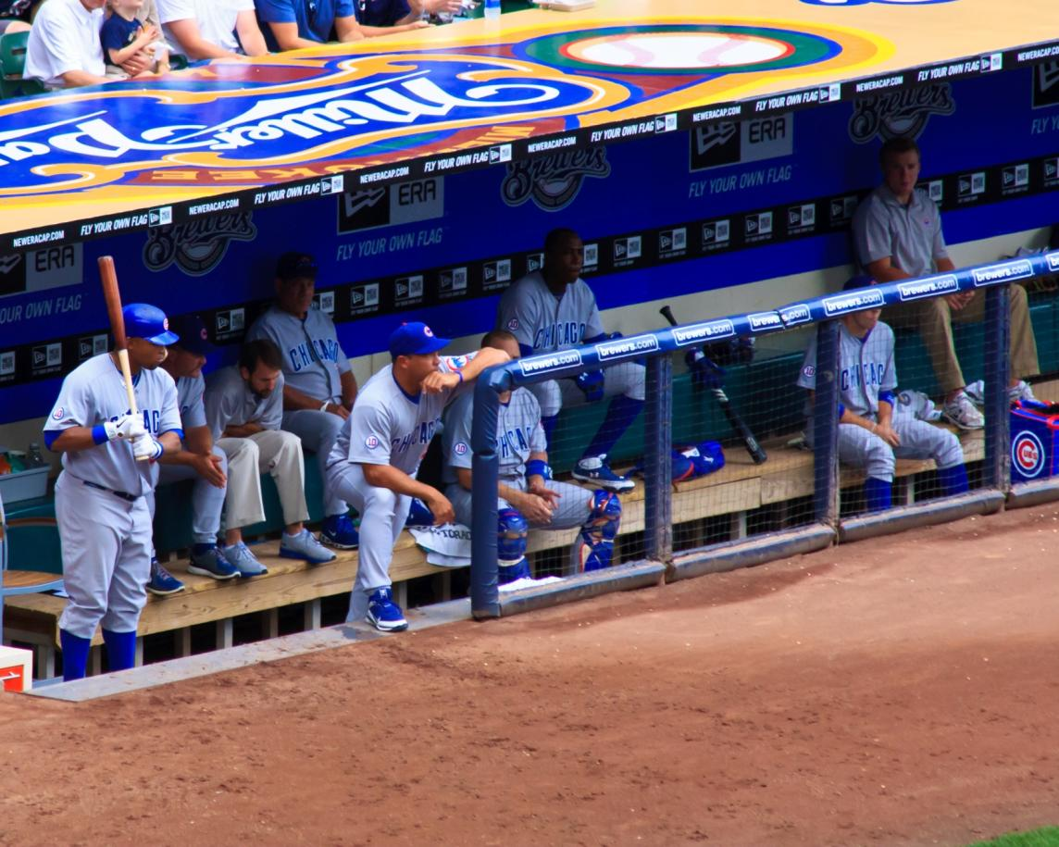
"Men's Club Minor League System and Player development"
- Building a Pipeline of Future Men's Club Executive Board Candidates.
How deep is your bench? Do you have a succession plan?
Think tank ideas for discussion at St. Louis Club Training
March 23, 2014. Prepared by M. Greenberg

Slide 2
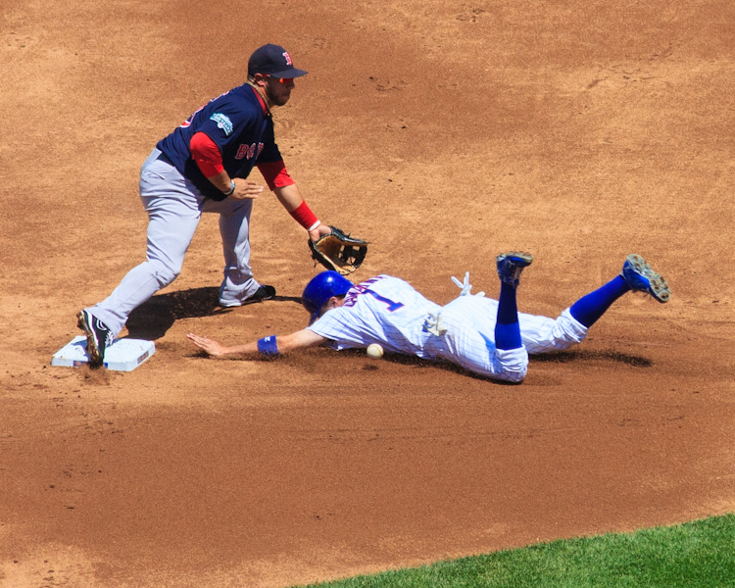
HOW DO YOU IDENTIFY TALENT?
MEN THAT WILL MAKE IT HAPPEN FOR YOUR CLUB?
WHO DOES THE SCOUTING? WHERE?

Slide 3
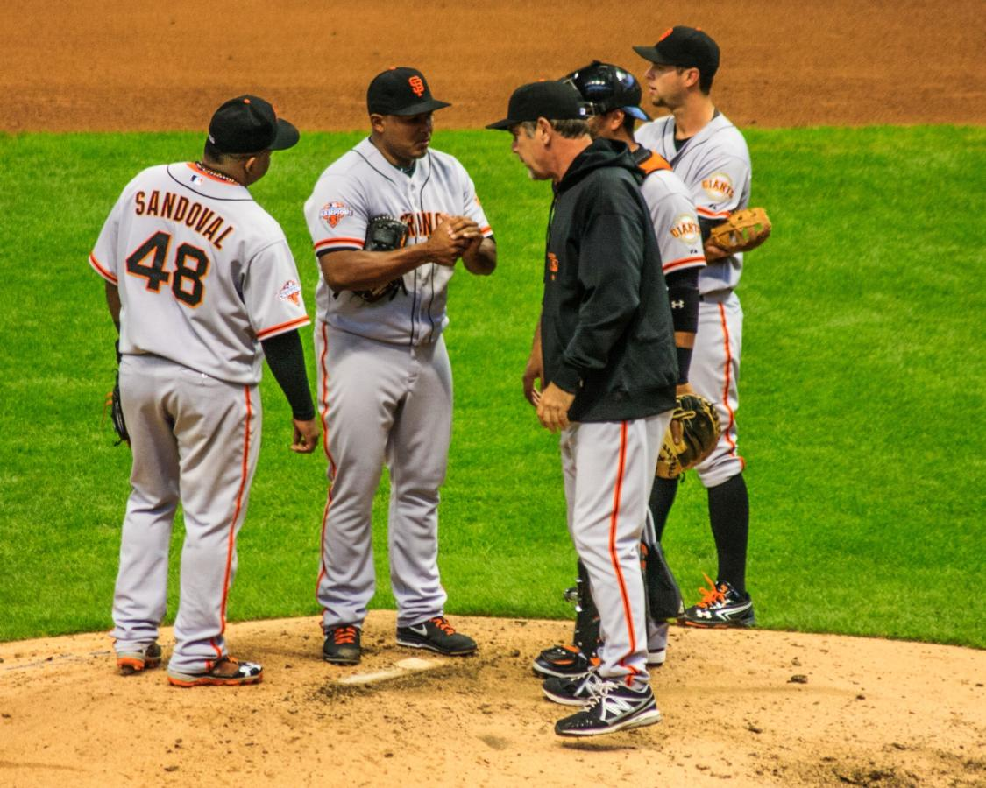
HOW DO YOU DEVELOP THE FUTURE CLUB LEADERS?

Slide 4
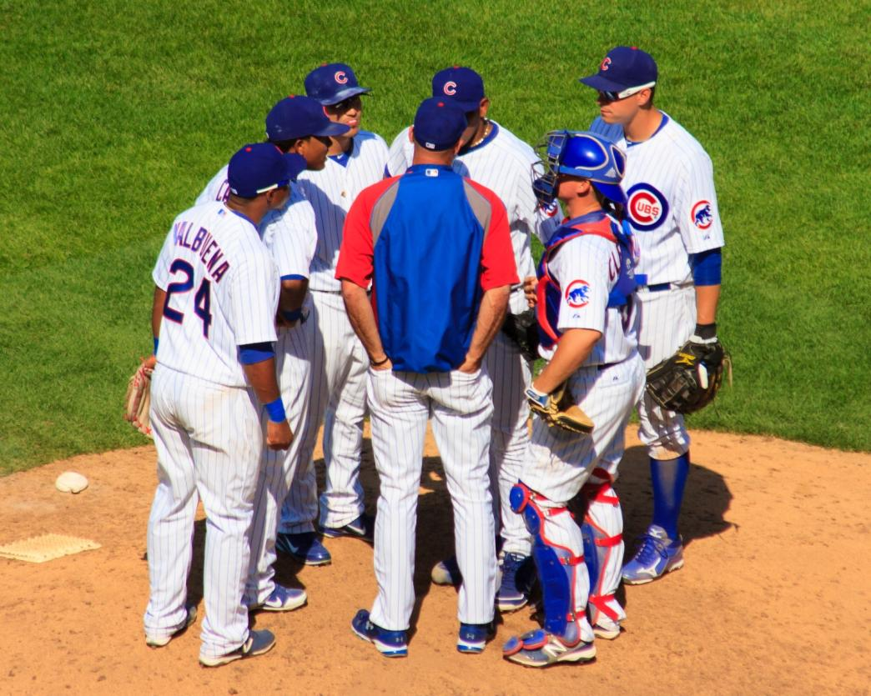
WHO COACHES THEM? WHAT SKILL SETS DO YOU INSTILL UPON THEM?

Slide 5
WHERE DO YOU START?
THE CLUB NEEDS FUNDAMENTALS IN PLACE:
MISSION
VISION
OFFICER ROLES AND RESPONSIBILITIES
A PROCESS FOR NOMINATING OFFICERS AND HOLDING ELECTIONS
TERM OF OFFICE
MOST CLUBS HAVE THESE DEFINED IN BY LAWS
NO BY LAWS?? MAY CONSIDER PREPARING THEM
WE CAN PROVIDE A TEMPLATE.

Slide 6
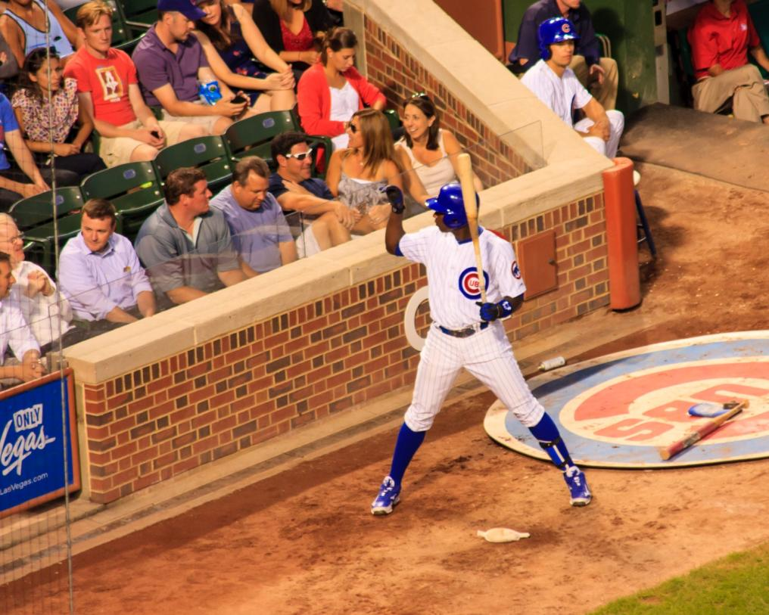
FUTURE LEADERS STAY FOCUSED ON THE VISION AND GOALS AND DO
NOT STRAY FROM THE MISSION.

Slide 7
CLUBS MAY HAVE THE FUNDAMENTALS IN PLACE, BUT THERE MAY BE OBSTACLES TO OVERCOME
NOMINATING COMMITTEE:
MAY NOT KNOW THE UP AND COMING MEN AND THEIR ACCOMPLISHMENTS
IS A TEMPORARY BODY- THEY CREATE THE SLATE AND DISBAND
HAVE NO OBJECTIVE IN PEOPLE DEVELOPMENT
HAVE NO LONG TERM SUCCESSION PLAN OR PROGRAM TO BUILD TALENT
MAY NOT KNOW THAT AN ENCUMBENT WANTS TO STAY PUT FOR ANOTHER 2 YEARS (IE TREASUER)
MAY NOT OFFER A POSITION TO A CURRENT BOARD MEMBER AND NOT TELL HIM BEFORE THE SLATE IS PUBLISHED. (A VERY POOR PRACTICE)
CURRENT EXECUTIVE BOARD:
FOCUSED MORE ON THE CLUB OPERATION AND LEARNING THE ROPES WHILE IN OFFICE.
MAY BE JUST KEEPING HEADS ABOVE WATER- NOT HAVE ENOUGH BODIES TO DO THE CURRENT JOB

Slide 8
CREATE YOUR OWN MINOR LEAGUE SYSTEM- A TO AAA
A-
MEN WHO ARE CONGREGANTS, BUT DO NOT BELONG TO THE CLUB
CALL THEM ON THE PHONE, INVITE THEM TO AN EVENT. PICK THEM UP AND TAKE THEM HOME. DO NOT EMAIL OR TEXT, CALL!!! BUILD RELATIONSHIPS & MEMBERSHIP.
DEVELOP RELATIONSHIPS WITH MEN OF VARYING AGE. RAPPORT WILL HELP GET THEM INVOLVED
AA-
MEN WHO ARE MEMBERS, HAVE ATTENDED A FEW EVENTS- ASK THEM TO JOIN THE MITZVAH SQUAD.
DO A SMALL TASK, A FAVOR, BUT ARE NOT ELECTED AND NEED NOT ATTEND MEETINGS.
CALL THEM ON THE PHONE, TAKE THEM TO COFFEE OR HAVE A BEER. ASK IF THEY CAN JUST DO A FEW SMALL THINGS FOR THE CLUB.
GET MENTIONED IN BULLETIN ARTICLES OR GIVEN SOME KIND OF RECOGNITION
CAN YOU THINK OF OTHER A, AA APPROACHES?

Slide 9
MARCH 23, 2014 WORKSHOP AT KOL RINAH- PARTICIPANT INPUT
A- ENGAGING MEN WHO ARE CONGREGANTS, BUT DO NOT BELONG TO THE CLUB
Engage non-members of synagogue – ECC parents, Day School,
Personal calls/outreach to new members and ask how they can get engaged.
Dedicated programs specifically for new members.
Long-time shul members who are not active in men’s club
How do we change the mindset & image?
How do we get guys to come back?
Plan events for all ages, including single guys.
Ask how men want to communicate – phone, email, FB, TW, Face-to-Face, etc.

Slide 10
MARCH 23, 2014 WORKSHOP AT KOL RINAH- PARTICIPANT INPUT
AA- ENGAGING MEN WHO ARE MEMBERS, HAVE ATTENDED A FEW EVENTS.
Sub co-chair event recognition (Scotch/Sukkah, Dad & Kid Breakfast)
“Bring a Friend” / Convenience
Attend events regularly
Survey member/potential member interests
Develop fun, memorable programs
Targeted asking
Follow up – Opinions
Don’t over commit, or ask, or over sell
FUN!!
Low cost or no admission charge
Diversity of Club programs
Small groups/Community Chavarot
HMV – Focused topics
Time considerations
Sports oriented programming
Plan child friendly events

Slide 11
CREATE YOUR OWN MINOR LEAGUE SYSTEM - CONTINUED
AAA-
ENTRY LEVEL EXEC. BOARD POSITIONS- SHADOW VP’S TO LEARN ROPES
RECORDING SECRETARY
CORRESPONDING SECRETARY
FINANCIAL SECRETARY
CREATE A CABINET-
THEY WORK ON TASKS FOR EXECUTIVE BOARD
BECOME COMMITTEES FOR MEMBERSHIP, PROGRAMMING, WAYS AND MEANS ETC.

Slide 12
CREATE DEPTH WHILE IN THE MAJORS
MAJOR LEAGUE EXPERIENCE GATHERING METHODS:
ROTATE VPS INTO DIFFERENT POSITIONS BEFORE ELEVATING TO EXEC. VP.
2 YEARS EACH IN
PROGRAMS
WAYS AND MEANS
MEMBERSHIP
RITUAL
EXECUTIVE VP
LEADS BOARD MEETINGS IN YEAR TWO OF CURRENT PRESIDENCY
MANAGES A NEW IMPACT MAKING INITATIVE AND TEAM ASSIGNED TO IT

Slide 13
FUNDAMENTAL TOOLS FOR DEVELOPING OFFICERS AND BOARD MEMBERS
FJMC CLUB OFFICER TRAINING MANUAL
SEND FUTURE OFFICERS TO CONVENTION
SEND MEN TO RETREAT
BRING IN FJMC COACHES ETC.
GIVE THEM ASSIGNMENTS AS CABINET OR COMMITTEE MEMBERS – LEARN ON THE JOB

Slide 14
DEVELOPING OFFICERS AND BOARD MEMBERS
WHO DOES ALL OF THIS AND WHAT TOOLS TO USE???
FORM A TEAM OF COACHES AND MENTORS- USE PAST PRESIDENTS
HAVE A PAST PRESIDENT STEP UP TO RUN THE SYSTEM AND A SMALL COMMITTEE OF OTHER PAST PRESIDENTS.
ASSIGN MEMBERS A PAST PRESIDENT TO LEARN FROM
CREATE SCORE CARDS TO GUIDE PAST PRESIDENTS AND NOMINATING COMMITTEE MEMBERS
LIST CANDIDATE PAST OFFICES HELD
SKILL SETS HAVE, SKILL SETS NEED.
TALK TO BOARD MEMBERS AND FIND OUT WHAT AMBITIONS THEY HAVE

Slide 15
PAST OFFICE EXPERIENCE SCORE CARD- EXAMPLE
AN OVERVIEW OF PLAYER DEVELOPMENT IN THE SYSTEM

Slide 16
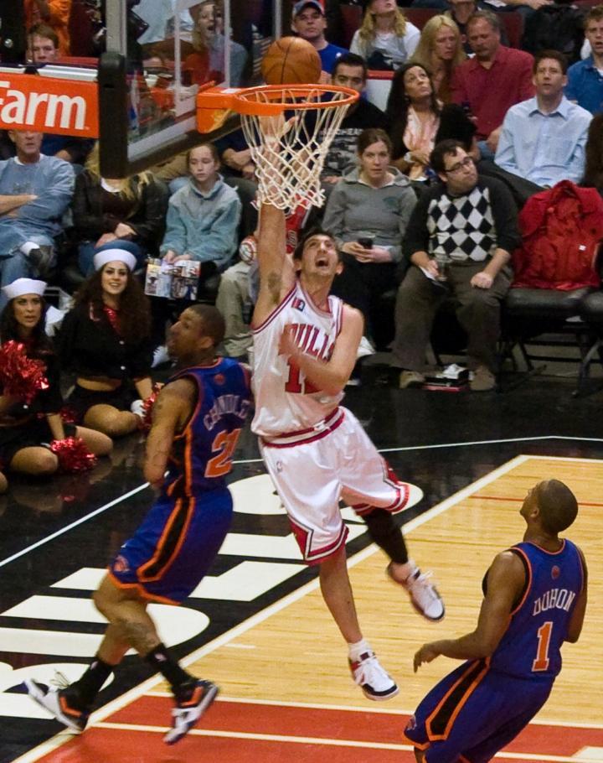
OFFICERS NEED VISION AND TENACITY THAT CAN ELEVATE THE CLUB TO GREATNESS

Slide 17
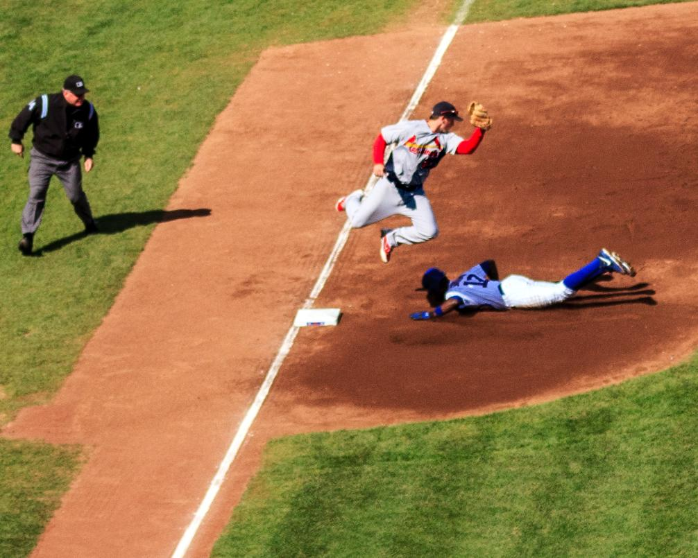
NEW OFFICERS SHOULD HAVE AN INNOVATIVE SPIRIT.
WILLING TO TAKE RISK AND TRY NEW THINGS

Slide 18
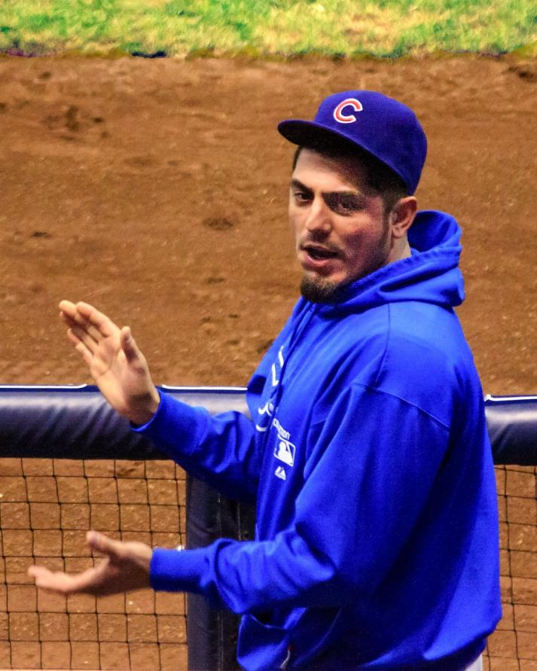
WILY VETERANS: COMMUNICATE OPENLY. OFFER ENCOURAGEMENT AND GOSSIP SUCCESS!

Slide 19
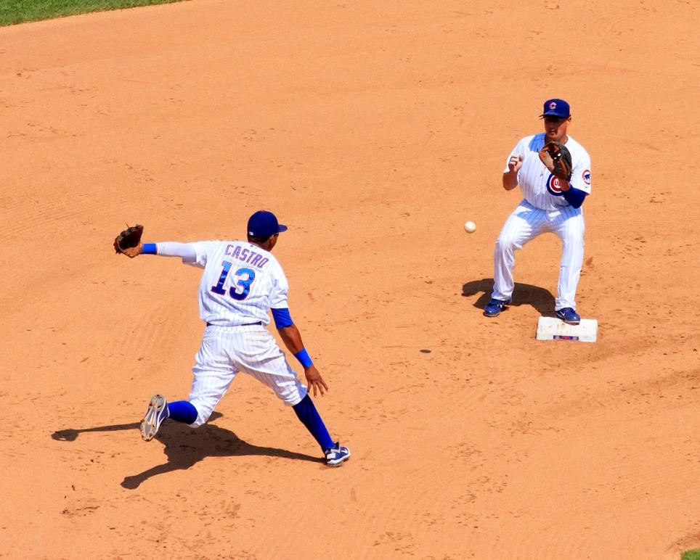
PLANNING AND ORGANIZATION IS KEY.
CAN DELEGATE AND ENCOURAGE TEAM WORK

Slide 20
CREATE A SKILL SET- COMPETENCY SCORE CARD FOR CANDIDATES
Position | Incumbent | Planning & Organizing | Sense of Urgency | Communi-cations | Innovative Spirit | Team work | Recommend-ations
NEED TO CREATE CRITERIA FOR GUAGING STRENGTH SUCH AS STRONG, AVERAGE OR NEEDS IMPROVEMENT.
SIMPLE BULLET POINTS CAN DO.
HAVE GROUP OF EX PRESIDENTS , OUTGOING PRESIDENT, EXEC. VP GRADE THEM.
CAVEAT- FORMER PRESIDENTS NEED TO BE ENGAGED

Slide 21
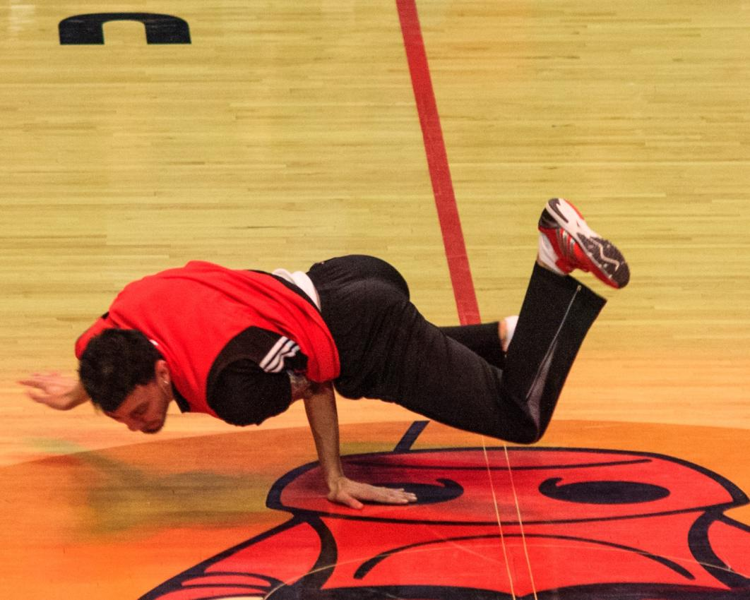
NEW OFFICERS NEED AGILITY AND STRENGTH –
TO MANUVER AND ENDURE…

Slide 22
TO HOLD THEIR OWN WHEN DEALING WITH OTHER ARMS OF THE SCHUL
WHOSE SISTERHOOD IS THIS??!!

Slide 23
STRIVE TO CREATE SUCCESSION PLANS GOING OUT FOUR TERMS OF OFFICE.
LIST MULTIPLE CANDIDATES PER POSITION AS NEEDED.
POSITION | 2015-2017 | 2017-2019 | 2019-2021 | 2021-2023
President
Exec VP
VP Programs
VP Ways & Means
VP Membership
VP Ritual
Treasuer
Financial Secretary
Recording Secretary

Slide 24
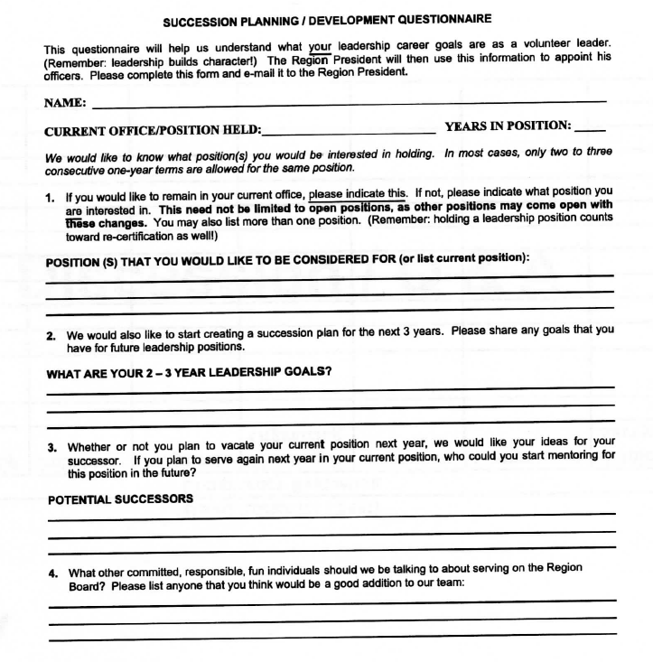
CURRENT PRESIDENT MEETS WITH CURRENT AND FUTURE BOARD MEMBERS, ASK THEM ABOUT THEIR FUTURE PLANS, GOALS & DESIRES

Slide 25
BREAK OUT DISCUSSION:
TAKE 15 MINUTES AND COLLECT IDEAS ON THE FOLLOWING:
GROUP 1
WHAT IS OUR SINGLE A MINOR LEAGUE SYSTEM (CONGREGANTS, NOT CLUB MEMBERS) TO RECRUIT THEM? WHAT IS WORKING AND WHAT NEEDS IMPROVEMENT?
GROUP 2
WHAT IS OUR AA SYSTEM (MEMBERS) IN OUR CLUB? WHAT IS WORKING AND WHAT NEEDS IMPROVEMENT?
GROUP 3
AAA- BOARD MEMBERS OR ENTRY LEVEL EXEC BOARD MEMBERS, HOW DO WE DEVELOP THEM? WHAT IS WORKING? WHAT NEEDS IMPROVEMENT?
APPOINT A SPOKES PERSON TO TELL US THE RESULTS IN A 3 MINUTE SUMMARY.

Slide 26
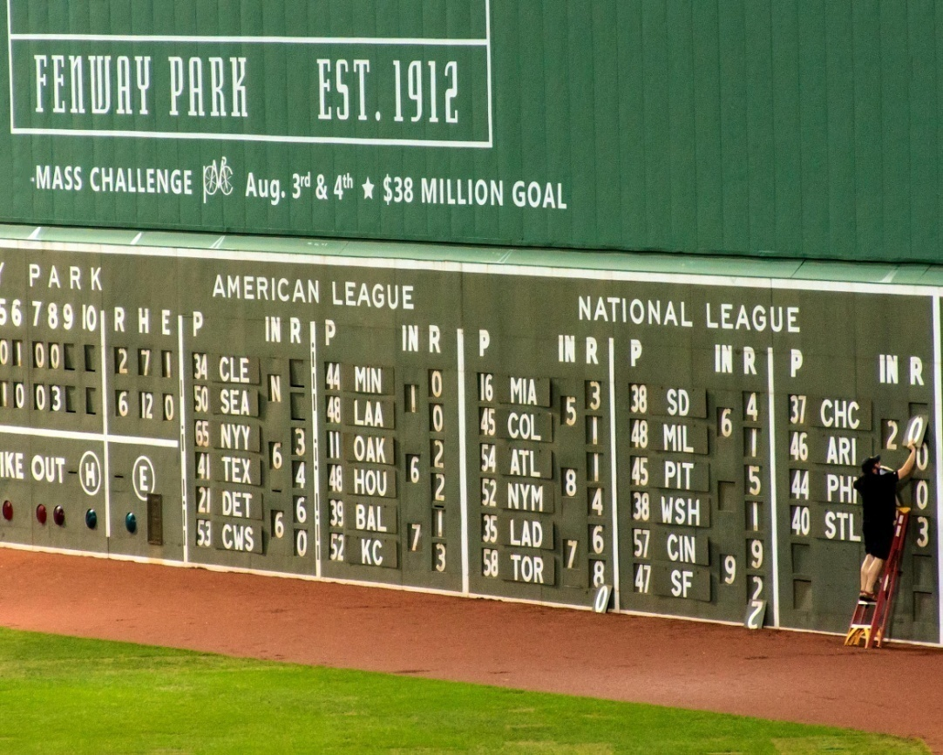
WRAP – UP: "Men's Club Minor League System and Player development“
CLUBS WITH LONGEVITY HAVE:
A PIPELINE OF LEADERS
WE DISCUSSED:
PLANS FOR ATTRACTING AND DEVELOPING FUTURE LEADERS
KEEP SCORE ON WHO IS GETTING READY
FORMAL PROCESSES DESIRABLE
KEEPS THE NOMINATING COMMITTEE FROM FUMBLING AROUND FIGURING OUT WHO TO CALL.
THOSE WHO DO NOT PLAN IN THIS AREA, MAY WISH THEY HAD.

Slide 27
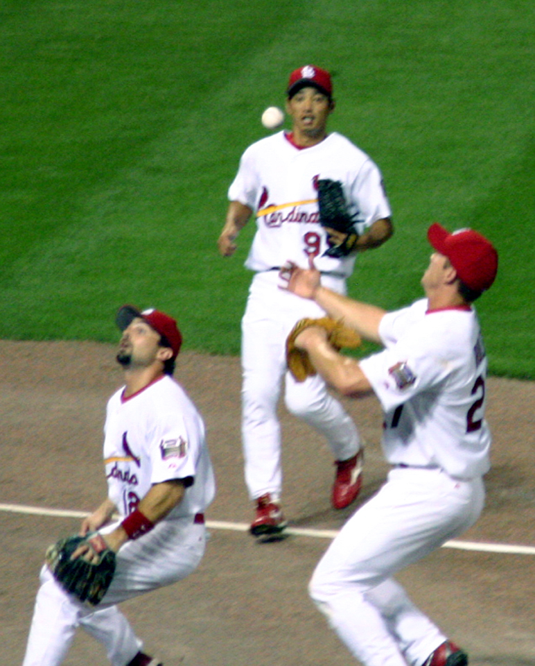
PLEASE, DO NOT DROP THE BALL FOR YOUR CLUB
MARCH 23, 2014 TRAINING SESSION
THANK YOU TO 17 PARTICIPANTS:
Mike Greenberg, Region Presenter
Norwin Merens, Region
Kol Rinah:
Alan Schwartz
Gary Kodner
Jerry Raskin
Mitch Shenker
Larry Goodman
Dave Propper
Bob Olshan
Bnai Amoona:
Mark Givarz
Creighton Cohen
Al Finkelstein
Steve Goldman
Neil Peters
Max Brown
Mark Gersten
Ed Herzog

